Slide 1

MSC AUTOMOTIVE ENGINEERING
Topic
AI ETHICS
7080MAA - CONNECTED AUTONOMOUS VEHICLE CONTEXUALISATION
Created & Presented By:
SHIBAM GHOSAL
SID - 15460424

Slide 2

AI Ethics
Overview:
Reasons for the selection of this topic.
Present & Future challenges with the topic.
Importance to Connected Autonomous Vehicles.
Significance of the topic to my future work, and successful implementation in the industry.
Ethical implications to the community, environment, etc.

Slide 3

Overview:
Ethics is the ability to think critically about moral values which determine our actions when interacting with another person.
Artificial Intelligence (AI) is an intelligent machine which runs with a set of programs developed for performing certain tasks which require human Intelligence.
Ethics of AI are principle sets developed for AI to function in a society with interaction with humans ethically.
AI technology has been started to be introduced in various sectors which typically require human intelligence to do certain types of tasks.
However, even with the many benefits AI has brought it also has its many downsides. There have been many reports of the misuse of AI technology. This begs the question if who should be responsible for the mistake made by AI?

Slide 4
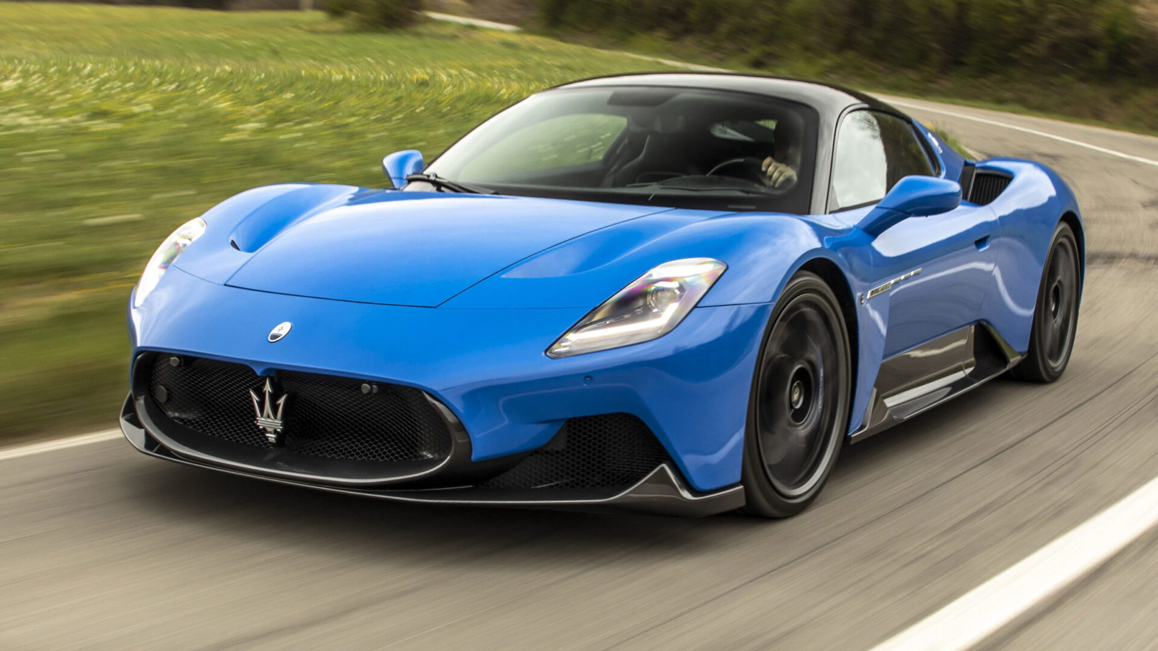
Current & Future challenges related to the topic:

Slide 5
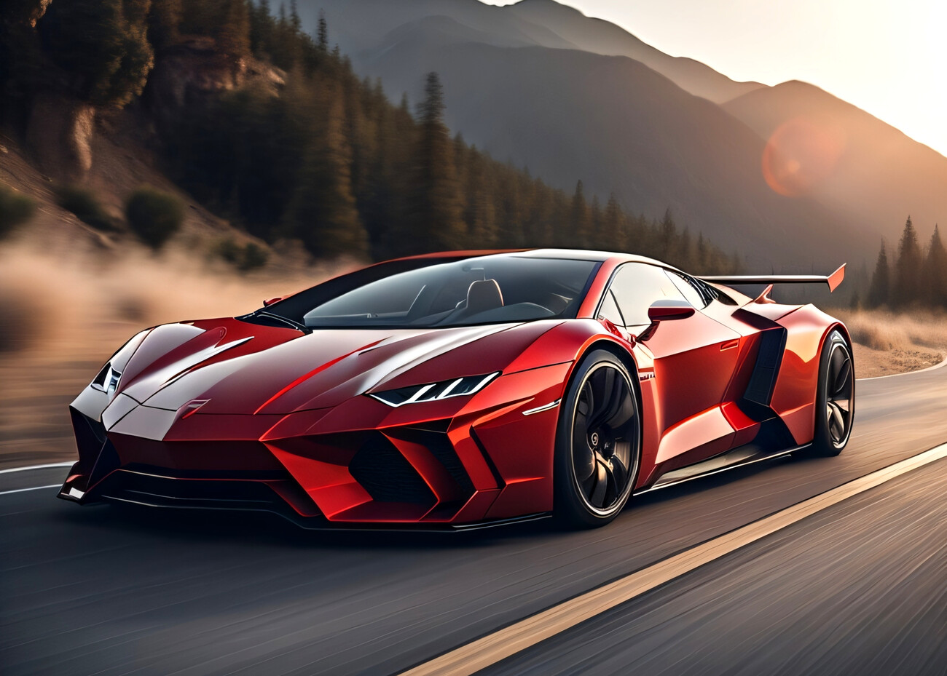

Slide 6
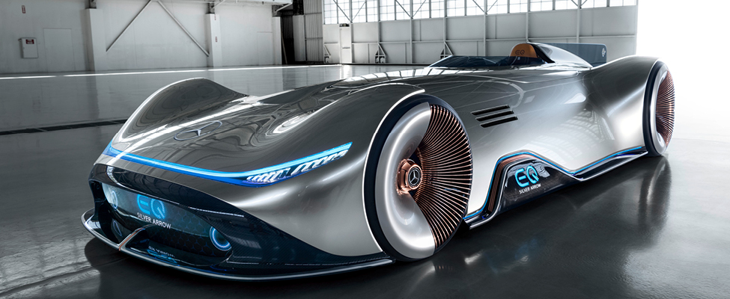

Slide 7
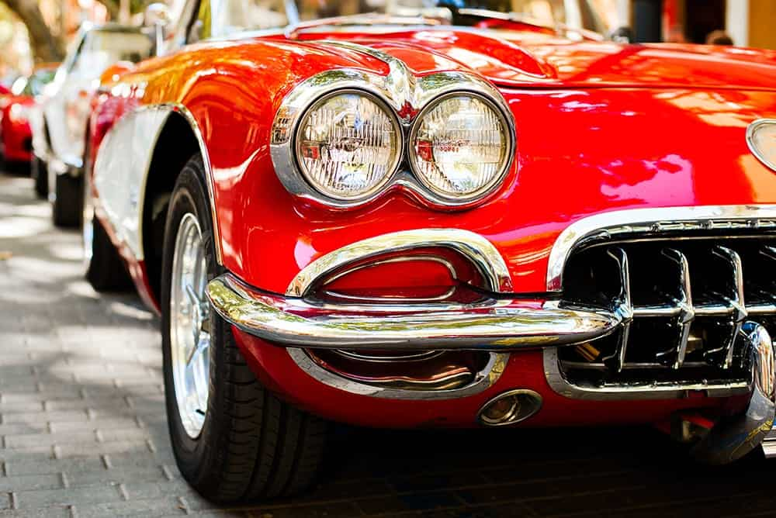

Slide 8

REFERENCES
Images for the making of slides:
https://www.moneybeach.co.uk/the-boardwalk/the-best-places-to-see-classic-cars-in-the-uk/
https://www.carwow.co.uk/best/best-supercars#gref
https://www.istockphoto.com/photos/ai
https://ats.net/en/focus-ai-artificial-intelligence-and-the-new-doomsday-machine/
https://www.ukposters.co.uk/fast-red-car-v127588
https://www.youtube.com/watch?app=desktop&v=_adJBzQgfsg
Research Materials:

